Slide 1
Object-Oriented Modeling
Using UML
CS 3331

Slide 2
Outline
State machine diagram
  Basic elements
  Structuring state machines

Slide 3
State Machine Diagram
Depicts the flow of control using states and transitions by describing
  How an object or system changes over time
  Event (e.g., operation calls) it may respond to
  How it respond to them
Generalization of finite state machines
  Capture state-dependent behavior precisely
Good for modeling reactive systems
  Passive nature (vs active)

Slide 4
Modeling Object States
Graph representing finite state machine
Network of states and transitions
button pressed
On
Off
button pressed

Slide 5
Elements of State Machine Diagram
Initial state
Final state
Transition
Idle
Running
State

Slide 6
State
Condition or situation in the life of a system (or object) during which it:
  Satisfies some condition,
  Performs some activity, or
  Waits for some events.
Set of values of properties that affect the behavior of the system (or object).
  Abstraction over object’s concrete fields
  Determines response to an event,
  Thus, different states may produce different responses to the same event

Slide 7
State (Cont.)
Examples
  The invoice is paid.
  The car is parked.
  The engine is running.
  Kate is working.
  Jim is playing.
  All ships are placed.
  A Game is over.
  The system is waiting for a player’s move.

Slide 8
Transition
Relationship between two states indicating that a system (or object) in the first state will:
  Perform certain actions and
  Enter the second state when specified event occurs and specified condition is satisfied.
Consists of:
  Source and target states
  Optional event, guard condition, and action
Source
Event [Condition] / Action
Target

Slide 9
Definition
Event
  An occurrence of a stimulus that can trigger a state transition
  Instantaneous and no duration
Action
  An executable atomic computation that results in a change in state of the model or the return of a value
  Run to completion
Guard
  Side condition enabling/preventing a transition
keyPressed(k) [k == ENTER_KEY] / buf := input

Slide 10
Example
pressed/turn on light
Off
On
pressed/turn off light
Q: Model a night light that automatically turns on and off?

Slide 11
In Class: Digital Watch
(Pairs) Draw a state machine diagram
The watch has a single mode button and a single advance button. Pressing the mode button once and then pressing the advance button increments the hours by 1. Each press of the advance button increments the hour. Pressing the mode button the second time allows advancing the minutes by one. Pressing the mode button a third time displays the current time. While displaying the current time, the advance button is ignored. Pressing the mode button allows the user to set the hour again.

Slide 12
More on States
Optional internal activities
  Actions and activities performed while in the state
  Action vs activity: atomic vs interrupt-able
  Predefined: entry, exit, do
Optional internal transitions
  Reaction within a state but without changing state
Name
Internal activities
Internal transitions

Slide 13
Internal Activities and Transitions
Internal actions/activities
  Entry: action performed on entry to state
  Exit: action performed on exit from state
  Do: activity performed while in the state
Attacking
entry/unsheathe sword
do/charge
exit/sheathe sword
enemy swings[distance<3 ft]/dodge

Slide 14
Example
[number.isValid()]
Starting
entry / start dial tone
exit / end dial tone
dialed (n)
Dialing
entry / number.append(n)
dialed (n)

Slide 15
Outline
State machine diagram
  Basic elements
  Protocol vs behavior state machines
  Structuring state machines
Sequence diagram

Slide 16
Structuring Diagrams
Can this diagram be presented better?
recovery success
recovery failure
Normal
anomaly
Recovery
Identification
temperature
pressure
recovery
failure
Pressure
Recovery
Temperature
Recovery
recovery
success
recovery
failure
recovery success

Slide 17
Composite States
Recovery
anomaly
Normal
recovery
success
recovery
failure

Slide 18
Composite States (Cont.)
Recovery
anomaly
Normal
Recovery
Identification
recovery
success
pressure
temperature
Pressure
Recovery
Temperature
Recovery
recovery
failure

Slide 19
Composite States (Cont.)
Used to simplify diagrams
Inside, looks like state machine diagram
May have composite transitions
May have transitions from substates
Sequential (OR) and parallel (AND) states

Slide 20
Composites and Transitions
Transition to/from composite state
Active
Idle
Validating
Selecting
Processing
Maintenance
Printing
Transition from substate

Slide 21
Exercise
Model a night light that
  Automatically turns on and off when it becomes dark or bright.
  Has a button to select a light color: white, blue, and red. The initial color is white, and pressing the button while the light is on changes it to the next color.

Slide 22
Parallel Composition
Concurrency (split of control)
Synchronization
Superstate
substate1
substate2
substate3
substate4

Slide 23
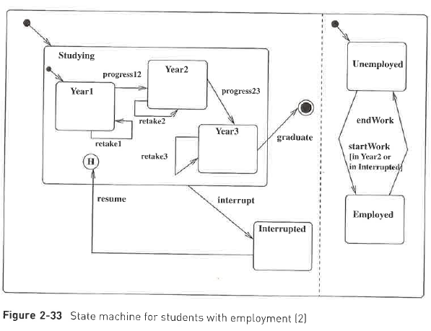
Example

Slide 24
Exercise
Model a night light that
  Automatically turns on and off when it becomes dark or bright.
  Has a button to select a light color: white, blue, and red. The initial color is white, and pressing the button changes it to the next color in the color sequence. The button works regardless whether the light is on or off.

